Slide 1
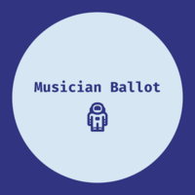
Musician Ballot
#Music-On-The-BlockChain

Slide 2
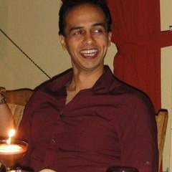

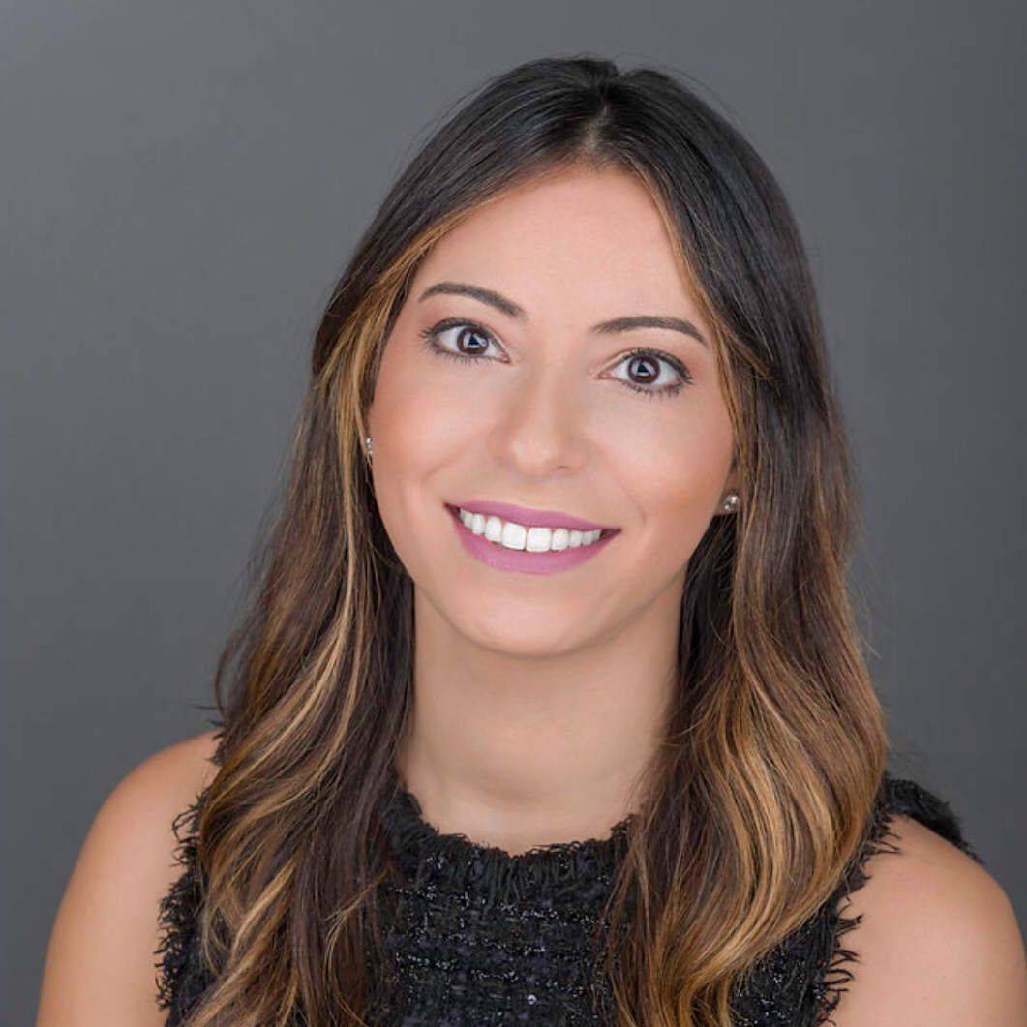

The Team
Roland Ferrao
Armen Arsenyan
Jennifer Rionda
Engineer with experience in building AI applications and newly expanded skill-set in blockchain
Advanced architect of smart contracts built on blockchain applications
Professional storyteller, amateur user experience designer and blockchain engineer

Slide 3
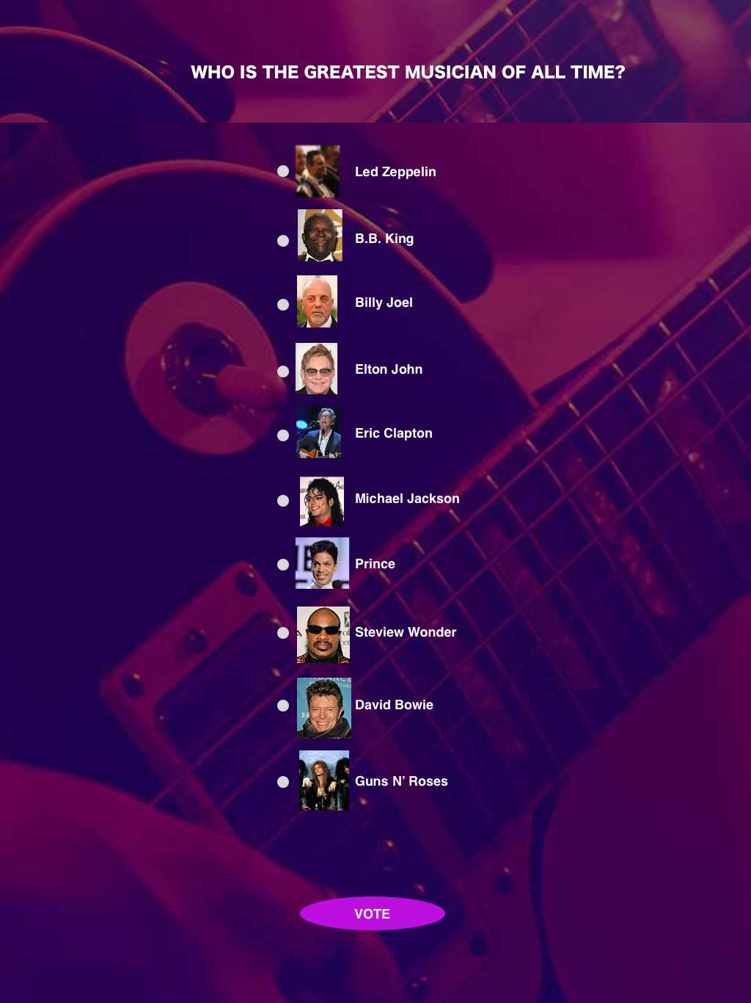
The Music Ballot (MB) App
Is a decentralized application built on the Ethereum blockchain that allows users to vote on their favorite musician from a predefined list

Slide 4
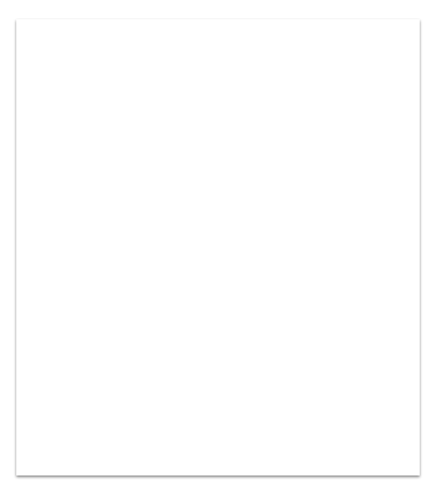
The voting transaction
Is registered on the blockchain using the Rinkeby testnet and MetaMask wallet
Java/CSS/HTML/web3.js (UI)
MetaMask (Wallet)
Ethereum (Blockchain)
Truffle (Dev Environment)
Solidity (Contract Language)
Rinkeby (Network)

Slide 5
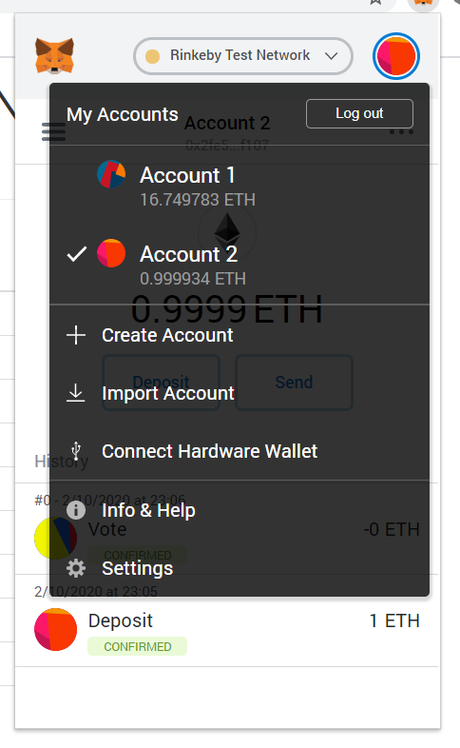
How to use the app
Create an account in MetaMask on the Rinkeby network
Obtain ether on the Rinkeby network via the test faucet using a social network account OR phone a friend
Access the Musician Ballot app
Review the pre-selected list of best Musicians of all time and cast your vote
Confirm your vote was captured

Slide 6
Key benefits
Secure method to capture votes with broad application (e.g., electoral voting).
No duplication or deletion of votes for a unique address
Connected to a simple and intuitive user interface

Slide 7
Challenges
Resources engineered their solution on Solidity 0.4 so a bit of a learning curve
Learning curve for the Truffle suite, which allows you to develop locally, over Remix which is in browser testing
R

Slide 8
Now let’s test the app!
Open Metamask
Switch to the Rinkeby Network
Confirm you have received Ether from the team
Click on link: https://musicians-ballot-app.netlify.com/
Vote on your favorite musician

